Slide 1

Effective Bug Reporting
Farooq Rasheed

Slide 2
Issue Tracking System
After software testing
  Testers find a lot of bugs
  They need to tell the developers about the bugs
  They usually put them into a so-called issue tracking system
Compared with Mailing list
  Hard to manage, come with all other mails
  Not categorized by topic
  No features for describing specific aspects in SE (versions, components, commits, etc)

Slide 3
Issue Tracking System
A platform for developers to communicate with each other
Like a forum
People can register and raise a issue
The one who raise the issue will describe the issue in details
Others can comment

Slide 4
Issue Tracking System
What is special
More structured for describing issues
  Component, assignees, schedules, status, resolution
  Customizable
  Change the contents while progress is made (status, resolution)
Sometimes allow anonymous issue raising
  Users of software are involved
  They use the software and raise bugs

Slide 5
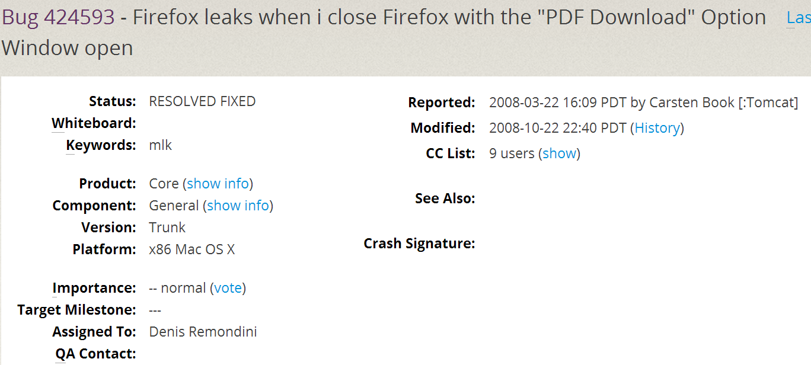
Issue: an example

Slide 6
Issues
Type of issues
Process of issues
Resolution of issues

Slide 7
Type of issues
Bug reports
Feature Requests
Patches

Slide 8
Type of Issues
Bug report (e.g., system shows wrong message)
  About a bug of the software
  Raised by a user/developer
  Should include:
    Step to reproduce
    Expected behavior
    Actual behavior
    Stack trace or error message if any

Slide 9
Type of issues
Bug reports
Feature Requests
Patches

Slide 10
Type of issues
Bug reports
Feature Requests
Patches

Slide 11
Type of issues
Bug reports
Feature Requests
Patches

Slide 12
Type of Issues
New feature (e.g., add sorting to results)
  About add a new feature, e.g., add sorting by modify time
  Raised by a user/developer

Slide 13
Type of issues
Bug reports
Feature Requests
Patches

Slide 14
Type of Issues
Patch (e.g., add checking for input validity)
  A fix to the software
  By a professional user, or a developer on a important fix
  Should include:
    Version to patch
    Patch code: basically a code diff, Diff (buggy, correct)

Slide 15
Type of issues
Bug reports
Feature Requests
Patches

Slide 16
Type of issues
Bug reports
Feature Requests
Patches

Slide 17
Process of an issue
Open/New
  The issue is raised
  Nobody in the project has looked at it yet
Assigned
  A person called triager assign issue to a developer
    Bug report: the developer will first reproduce the bug, and then try to fix
    Feature request: discuss with colleagues on whether to accommodate the request, and implement the feature
    Patch: Validate the patch
    Milestone: may be assigned to a sub-group

Slide 18
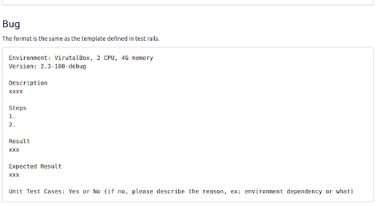
Template We Follow

